Slide 1
Applied Analytics ASG1
K-Means & Hierarchical Clustering
Presented by - Seo Shin Youn (S10205100K)
AA P03 April 2022 - Mr. Toh Ser Chye
2022
Notes:
A very good morning, afternoon, or evening Mr. Toh and fellow classmates. My name is Shin Youn, and I will be presenting the work that I have done for Applied Analytics Assignment 1 which focuses on building and evaluating K-Means and Hierarchical Clustering models based on the dataset regarding bank customers.

Slide 2
TABLE OF CONTENTS
01
Exploratory Data Analysis
02
Data Manipulation
03
Clustering
Models
04
Cluster Interpretation
Better understand the Bank Dataset through Descriptive Analytics
Perform Data Cleaning & Data Transformation to prepare our dataset for clustering
Build, Optimize, and Evaluate K-Means and Hierarchical Clustering Models
Business insights obtained from cluster interpretation
2022
Notes:
As part of this presentation, the first unit would cover ‘Exploratory Data Analysis’ where will try to better understand our data in order to find potential problems that we would want to correct in later stages. Following, we would cover ‘Data Manipulation’ where will fix the errors that we have previously identified through data cleaning and data transformation. Hence, this would allow us to adequately prepare our dataset in order to perform effective clustering. After which, we will be build, optimize and evaluate the K-Means and Hierarchical Clustering models using the common performance measure of Silhouette Score. Last but not least, we will end by interpreting the clusters we have previously created in order to derive business insights and value from.

Slide 3
01
EXPLORATORY DATA ANALYSIS
Understanding issues in our dataset to perform data cleaning and transformation subsequently
2022
Notes:
Now, I will be covering the exploratory data analysis processes that I have undertaken in order to understand potential issues that we would like to correct in our dataset.

Slide 4
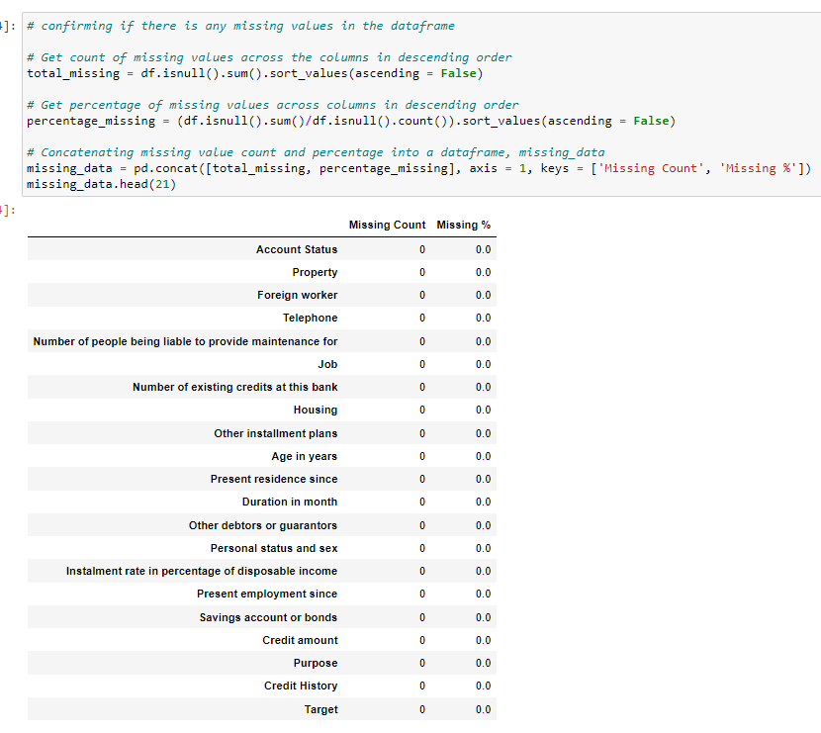
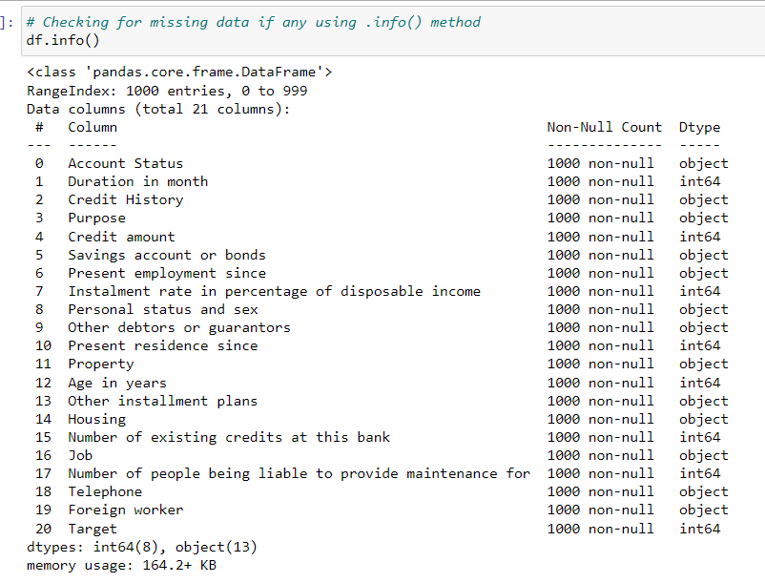
1.1 Identifying null values in the Bank dataset
No presence of null values (i.e. 1000 non-null count observed out of 1000 entries for all features)
Verifying presence of null values using df.isnull()
(i.e. 0 missing count + 0% missing for all features)
2022
Notes:
The first main issue that we would like to uncover would be to understand if there are any null values in our bank dataset in order to perform missing value treatment. Hence, through using the .info() method, we could observe that of the 1000 records present in our dataset set, all of the features also have a non-null count of 1000 which implies that there are no missing values. Additionally, to verify that there are no missing values in our dataset, I had also used the .isnull() method to count the number and percentage of missing values. Thus, we could confirm that no missing missing value treatment would have to be performed as all the features have 0 count and percentage of missing values.

Slide 5
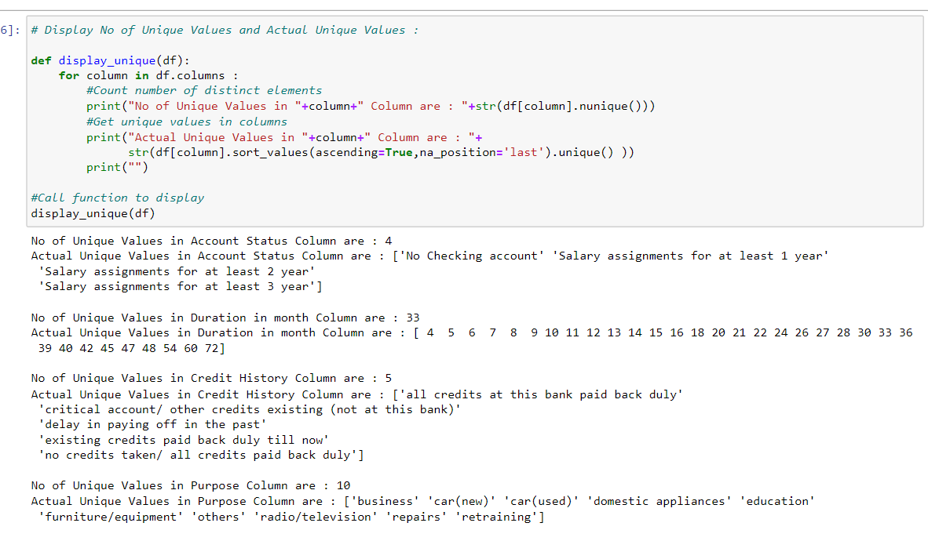
1.2A Number of Unique Values & Actual Value of Each Feature
Example of Output from the following code:
No. of unique values in Account Status Column = 4
Actual Unique values in Credit History Column = [‘all credits at this bank paid back duly’,...]
2022
Notes:
To better understand the bank customer dataset, what I had done was to create a function that loops through and output all the unique values and count of each feature. Hence, this would allow us to spot any abnormalities in our dataset to perform data transformation on. From the example I have illustrated, we could observe that we are able to obtain the number of unique values in Account Status which is equivalent to 4 while also viewing the unique values in the Credit History Column such as delay in paying off in the past, no credit taken etc.

Slide 6
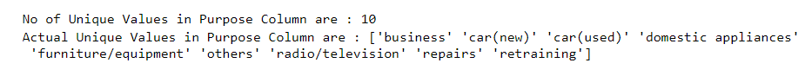
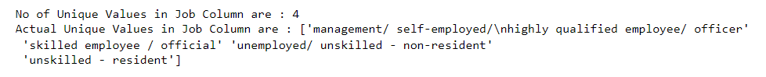
1.2B Identifying Potential Features to Drop from
Finding the unique values in each feature
Potentially Dropping Nominal Categorical Data (Not Meaningful for Clustering):
2022
Notes:
Hence, one of the benefits of the function that I have created in the previous slide is that it would allow us to identify nominal categorical features to drop. This is because given that there is no intrinsic ordering to such features, it would not be useful in building clustering models given that it is least precise and complex while also not having any quantitative value. Hence, this features that we would potentially be dropping includes purpose, personal status and sex, property, values in other installment plans, as well as Job.

Slide 7
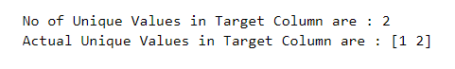
1.2C Identifying Potential Features to Drop from
Finding the unique values in each feature
Potentially Dropping Irrelevant Feature(s):
Target Feature - Only useful for predictive modeling which is not our focus:
‘Savings account or bonds’ Column - Only has one feature/Same for all entries:
2022
Notes:
Additionally, by determining the count and unique values of each feature, we would also want to drop the following features given that the Target Column would only be used in predictive modelling which is not the focus of this project while the Savings account or bonds column only have 1 entry of Savings account. Hence, given that the Savings account or bonds column is equally distributed across all data entries, it would not be useful in the process of building clustering models.

Slide 8
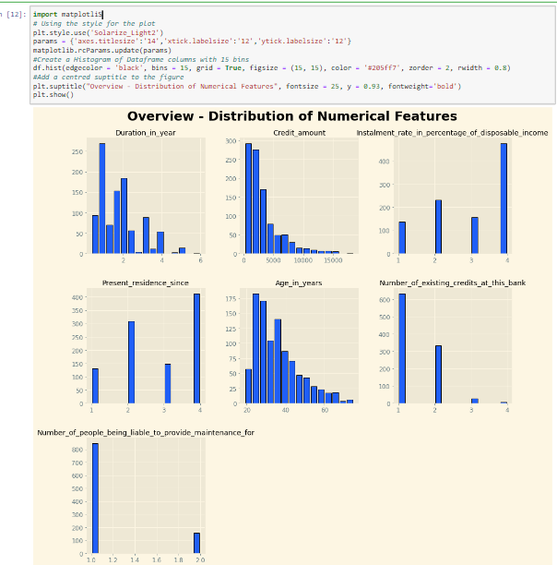
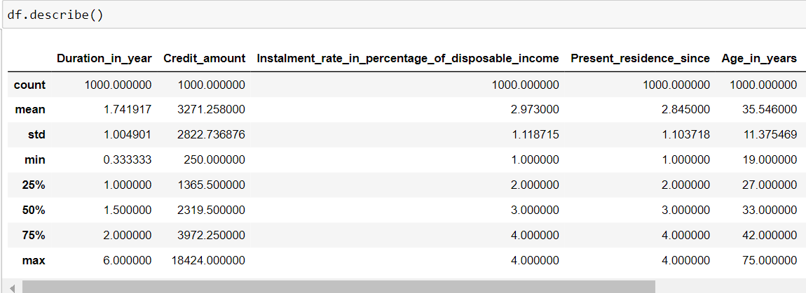
1.3 Overview - Distribution of Numerical Features
Observation of Distribution:
‘Duration in month’, ‘Credit amount’, and ‘Age in years’
Features have positively skewed distribution and are on different scales
How to normalize & scale data for effective clustering:
Perform Log Transformation to handle outliers and obtain normal distribution
Apply Z-Score Transformation to scale features to the same magnitude
2022
Notes:
The last part of our exploratory data analysis process aims to look at the distribution of the numerical features in the dataset. Hence, by observing the distribution of non-discrete variables, we could observe that for the Duration_in_year column, Credit_amount column, and Age in Years column, they are positively skewed in nature and have varying scales. Hence, we would need to normalize these distributions given that it may create biases when calculating the euclidean distance as part of the K-Means and Hierarchical Clustering models in the presence of outliers and skewed distribution. Thus, to produce a normal distribution for the following features highlighted, we could make use of log transformation given that it is effective in handling positively skewed distribution and outliers. Additionally, we could also apply Z-Score transformation through standard scaler which would ensure that the variables that are being compared against are of the same range and magnitude.

Slide 9
02
DATA MANIPULATION
Data Cleaning & Transformation Procedures to prepare dataset for clustering
2022
Notes:
Now, I will be covering the data manipulation processes that I have undertaken in order to adequately prepare our dataset for effective clustering through data cleaning and transformation.

Slide 10
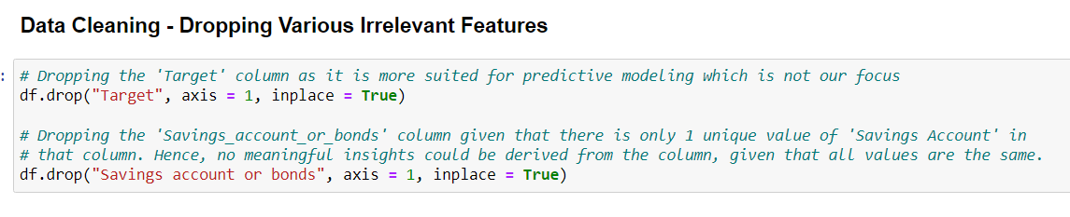
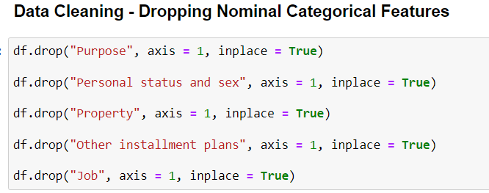
2.1 Dropping Irrelevant & Nominal Categorical Data
Not useful for clustering analysis
Hard to rank given that these features have either different metrics of comparison or ordering of such values is non-quantifiable and subjective
2022
Notes:
Firstly, as part of our data cleaning processes, what I had done was to drop the irrelevant and nominal categorical data in our dataset in order to better focus on useful features in our dataset for further analysis. Hence, as the target feature is only used for predictive modelling while every entry has a value of savings in the Savings account or bonds column, we would deem them as irrelevant. Additionally, for columns including purpose, personal status and sex, property, other instalment plans, and job; as they are nominal categorical data, they are hard to rank and often have different metrics of comparison, making them non-quantifable and subjective based on the opinions of others. As such, we would have to drop them as label encoding would not be effective. An alternative would be One Hot Encoding, however, it is more suited for predictive modelling as it would make our dataset unnecessarily more complex with more features to analyse.
‘

Slide 11
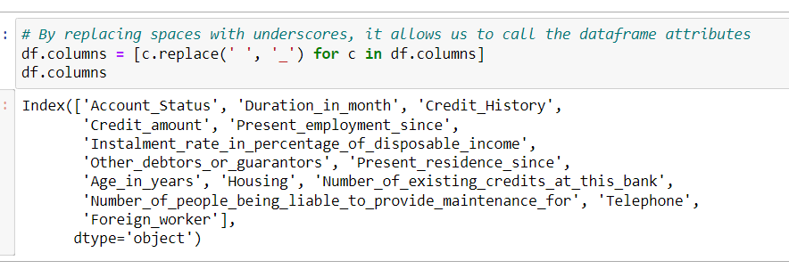
2.2 Replacing Feature Name Spaces with Underscores
Example of Output from replacing spaces with underscores in column name:
‘Account Status’ → ‘Account_Status’
Rationale/Benefits:
Allows us to easily access objects from the dataframe where spaces would make it inaccessible (E.g. df.Credit_amount.mean())
2022
Notes:
The next part of our data manipulation process involves replacing the space in the names of the various features with underscores instead. This is because without converting the name spaces to underscores, we would not be able to access the objects and their respective methods for further calculation and analysis. Hence, to replace the column name spaces with underscores, we will loop through each column using the df.columns object and using the replace method available for each column.

Slide 12
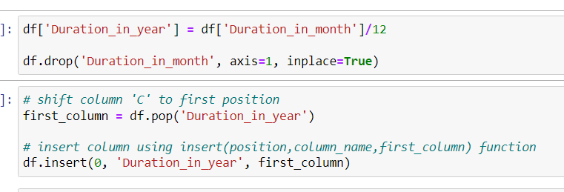
2.3 Replacing Duration_in_month with Duration_in_year
Create new column. ‘Duration_in_year’ by dividing ‘Duration_in_month’ values by 12
Drop ‘Duration_in_month’ from the dataframe permanently
Moving the new column to the first position in place of the old column
Rationale/Benefits:
Provides fair comparison when building clusters with other features such as ‘Age_in_years’, where year is being used as well.
2022
Notes:
Followingly, as we would be using the Duration in month variable together with the Age in Years variable when building the K-Means and Hierarchical Clustering model later on, I had created a new feature named duration in years in order to ensure that they are using the same metrics for comparison. Hence, this is done so by creating a new dataframe column and dividing the Duration in month column by 12 as its value before subsequently dropping the duration in month feature. Additionally, given that the duration in month column was in the first position of the dataframe previously, we would insert the duration in year column in the first column as well.

Slide 13
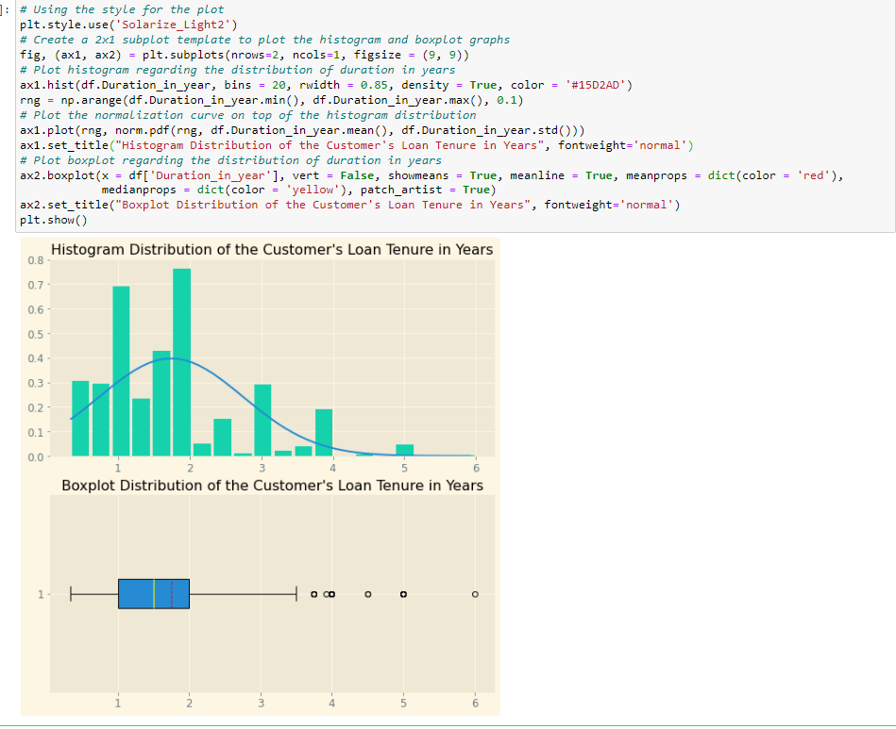
2.4A Distribution of Customer’s Loan Tenure in Years
Insights from our observation:
Distribution is positively skewed in nature
A few number of outliers observed
Data Transformation to be performed:
Log Transformation to handle outliers and normalize distribution
Z-Score Transformation to scale data to the same magnitude (Performed at later stages)
2022
Notes:
The next part of the data manipulation process involves normalizing the various numerical features. For instance, as observed from the distribution of the customer’s loan tenure in years, we could observe that the distribution is positively skewed in nature as observed from the histogram with the presence of a few outliers. In this case, we could perform log transformation which is able to handle positive skewness and outliers relatively well while also using z score transformation to scale data to the same range and magnitude.

Slide 14
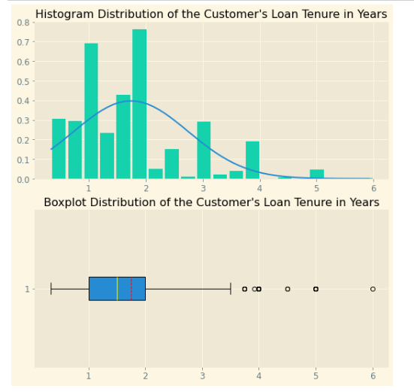
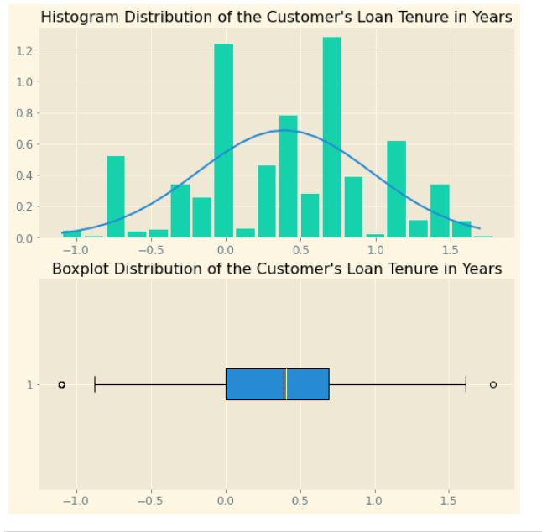
2.4A Performing Log Transformation on Loan Tenure in Years
Before performing Log Transformation:
After performing Log Transformation:
2022
Notes:
Hence, by performing log transformation using the numpy log method on the column, we could observe that the distribution has transformed from being positively skewed with a few outliers to being normally distributed with little to no outliers.

Slide 15
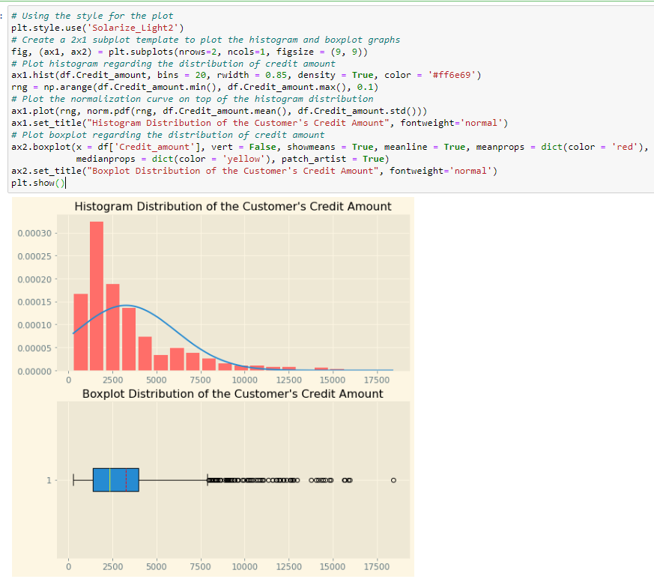
2.4B Distribution of Customer’s Credit Amount
Insights from our observation:
Distribution is positively skewed in nature
Large number of outliers observed
Data Transformation to be performed:
Log Transformation to handle outliers and normalize distribution
Z-Score Transformation to scale data to the same magnitude (Performed at later stages)
2022
Notes:
As we have previously performed log transformation on the duration in years column, the same could also be applied on the Credit Amount column and subsequently Z-score in later stages given that it has a positively skewed distribution and has a relatively large number of outliers in comparison.

Slide 16
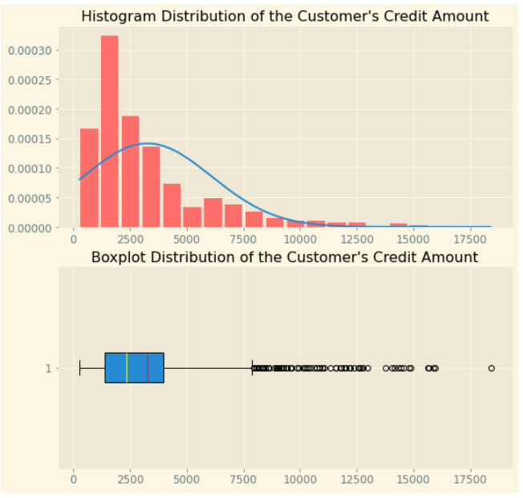
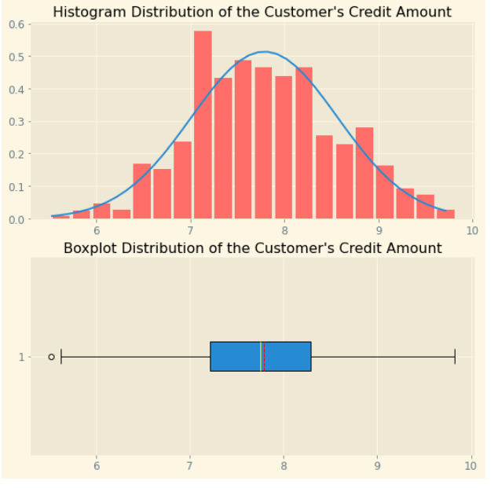
2.4B Performing Log Transformation on Credit Amount
Before performing Log Transformation:
After performing Log Transformation:
2022
Notes:
Hence, by performing log transformation on the Credit Amount column, we could observe that the once positively skewed distribution with a large number of outliers has transformed into a normal distribution with little to no outliers.

Slide 17
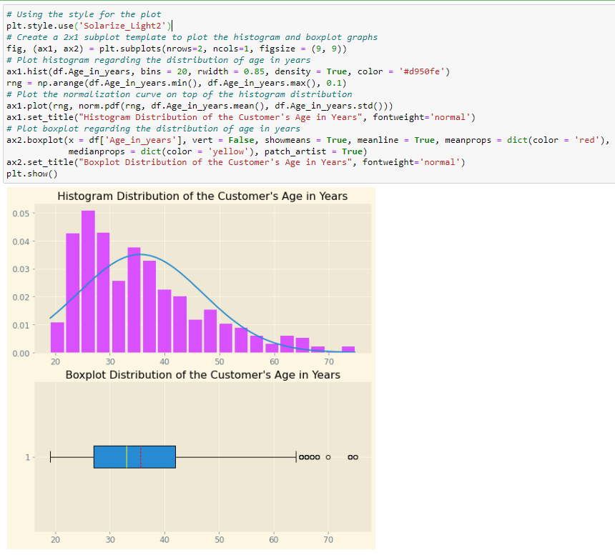
2.4A Distribution of Customer’s Age in Years
Insights from our observation:
Distribution is positively skewed in nature
A few number of outliers observed
Data Transformation to be performed:
Log Transformation to handle outliers and normalize distribution
Z-Score Transformation to scale data to the same magnitude (Performed at later stages)
2022
Notes:
Similarly, for the age in years column, we could also perform log transformation and subsequently z score transformation in later stages as evident of the positively skewed distribution as plotted from the histogram and the few number of outliers which needs to be handled as plotted from the boxplot.

Slide 18
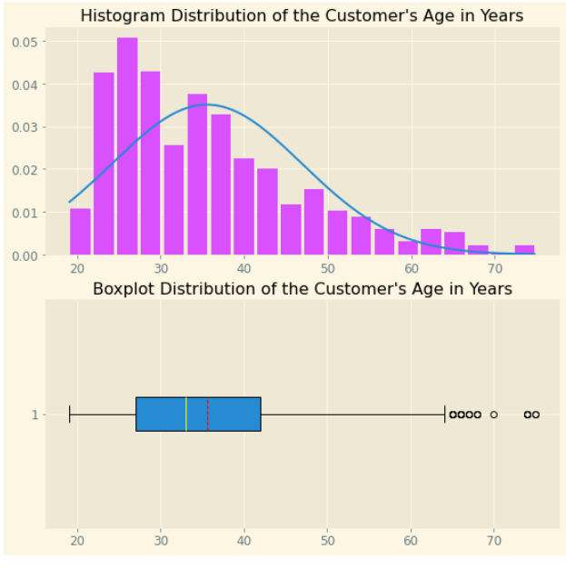
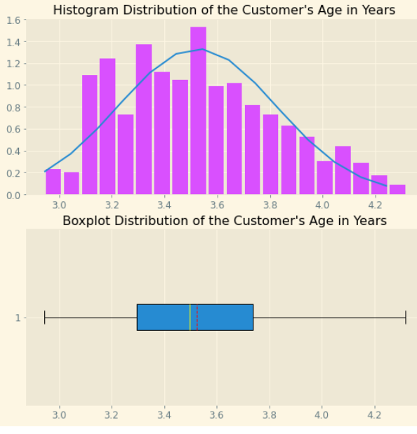
2.4C Performing Log Transformation on Age in Years
Before performing Log Transformation:
After performing Log Transformation:
2022
Notes:
Hence, by performing log transformation on the Age in Years column, we could observe that the once positively skewed distribution with a large number of outliers has transformed into a normal distribution with no outliers at all.

Slide 19
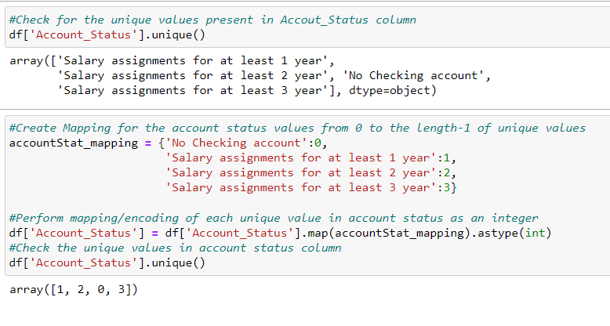
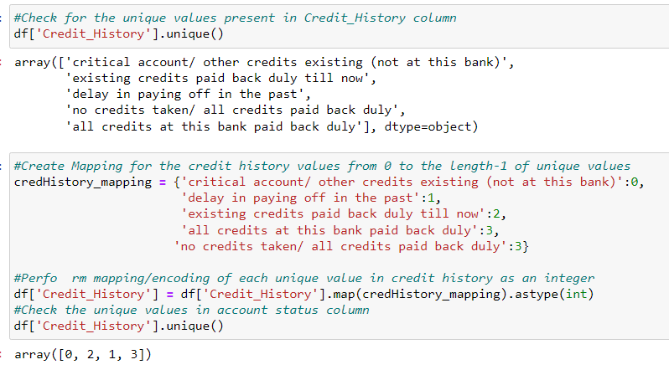
2.5A Label Encoding Ordinal Categorical Data
Rationale/Benefits of Label Encoding Ordinal Categorical Data:
Ordinal Categorical Data are features where order has meaning
Label Encoding enables us to create clusters with Ordinal Categorical Data beyond just numerical data available
Mapping of ‘Account_Status’ Column
Mapping of ‘Credit_History’ Column
Treating both ‘all credits at this bank paid back duly’
and ‘no credits taken/ all credits paid back duly’ as the same
Notes:
The next part of the data transformation process involves label encoding the ordinal categorical features in the dataset. Hence, as part of label encoding, it aims to convert the labels of ordinal categorical data into a numeric form so as to convert them into the machine-readable form. Thus, given that ordinal categorical variables comprises a finite set of discrete values with a ranked ordering between values, there is intrinsic value and benefit in ranking them through the use of ordinal encoding. As such to map the account status column, a value of 0 would be assigned to ‘no checking account’, a value of 1 would be assigned to ‘Salary assignment for at least 1 year’, a value of 2 would be assigned to ‘Salary assignment for at least 2 year’, while a value of 3 would be assigned to ‘Salary assignment for at least 3 year’. Whereas for the mapping of the Credit History column, a value of 0 is assigned to ‘critical account or other credits existing (not at this bank)’, a value of 1 is assigned to ‘delay in paying off in the past’, a value of 2 is assigned to existing credits paid back duly till now, while a value of 3 is assigned to both ‘all credits at this bank paid back duly’ and ‘no credits taken/ all credit paid back duly’ as they are quite similar in nature.

Slide 20
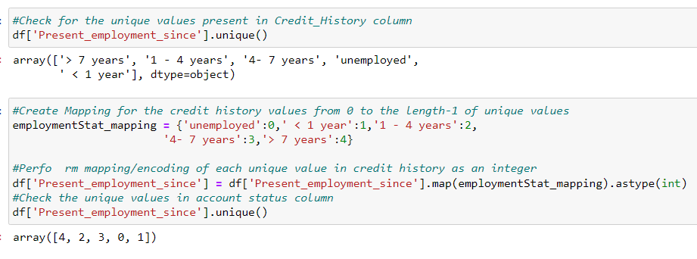
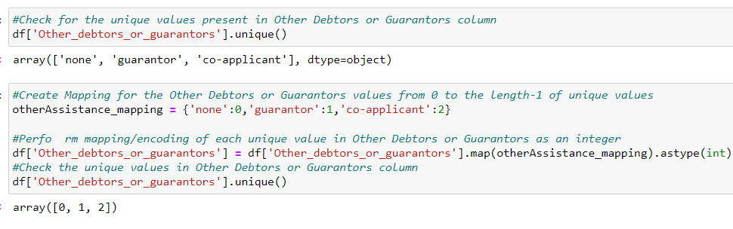
2.5B Label Encoding Ordinal Categorical Data
Mapping of ‘Present_employment_since’ Column
Mapping of ‘Other_debtors_or_guarantors’ Column
Notes:
As for the mapping of the present employment since column, a value of 0 is assigned to those unemployed, a value of 1 is assigned to those employed for less than 1 year, a value of 2 is assigned to those employed for 1 to 4 years, a value 3 is assigned to those employed for 4 to 7 years, while a value of 4 is assigned to those employed for more than 7 years. Additionally, for the mapping of other debtors or guarantors, a value of 0 is assigned to those with a value of ‘none’, a value of 1 is assigned to those with a value of ‘guarantors’, while a value of 2 is assigned to those with a value of ‘co-applicant’. Hence, the rationale why a co applicant is ranked higher than a guarantor is because he or she is obliged to repay the loan as well regardless of his or her status or relationship, while a guarantor is provided to those who can repay the loan him or herself but have history of bad credit.

Slide 21
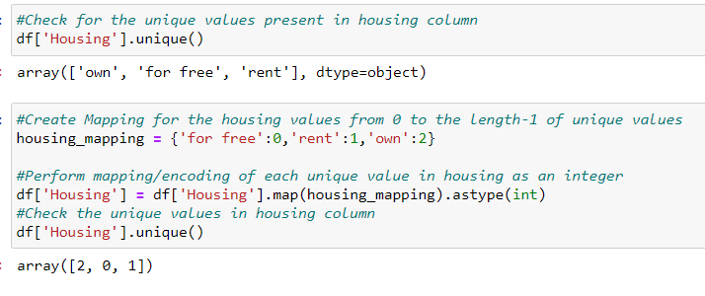
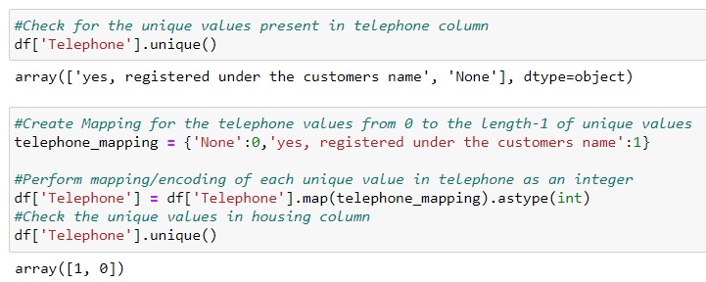
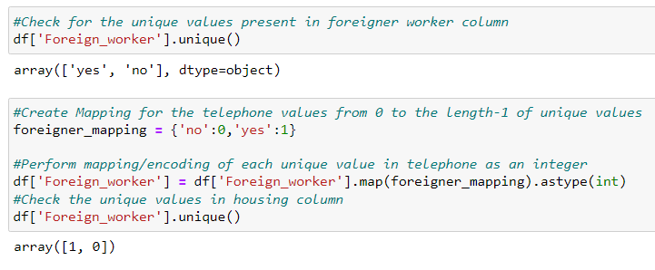
2.5C Label Encoding Ordinal Categorical Data
Mapping of ‘Housing’ Column
Mapping of ‘Telephone’ Column
Mapping of ‘Foreign_worker’ Column
Notes:
Last but not least, for the mapping of housing, they are ranked in ascending order of for free, rent, to own. As for the mapping of the telephone feature, they are ranked in ascending order of ‘None’, followed by ‘Yes’ while the foreign_worker column is mapped and ranked in ascending order of ‘no’ followed by ‘yes’.

Slide 22
03
BUILDING CLUSTERING MODELS
Building, Optimizing, Evaluating K-Means & Hierarchical Clustering models
2022
Notes:
Next, I will be sharing how we have built, optimized and evaluate the various K-Means and Hierarchical Clustering model for further analysis.

Slide 23
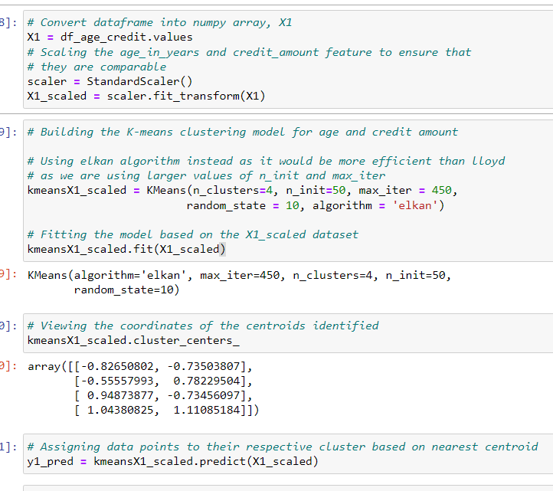
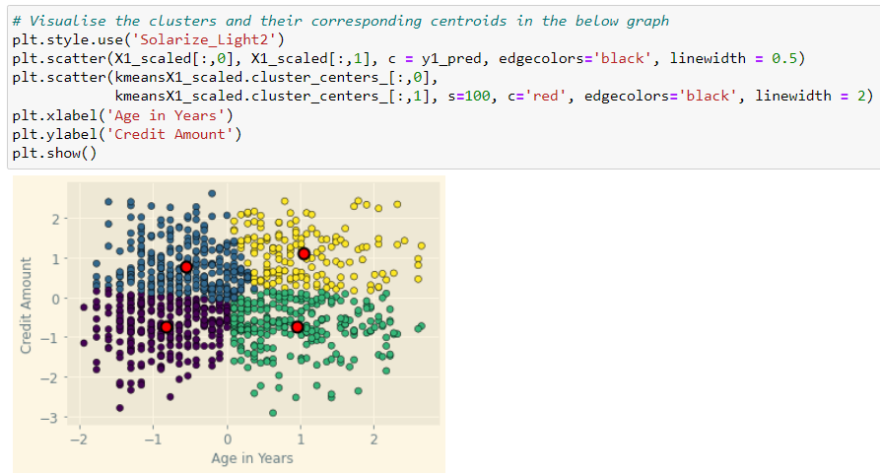
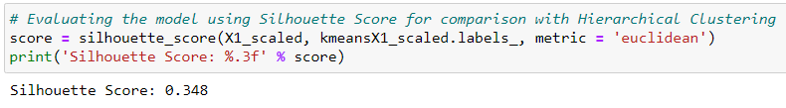
3.1A Building K-Means Clustering Model
with Age_in_Years & Credit_Amount
Objective: Understand which age group of bank customers to target based on the credit amount that they have taken (More Credit → Higher Revenue from Interest)
Z-Score Transformation
Building with 4 Clusters
Initially and fitting model
Assigning Cluster Group
Notes:
Hence, for our first K-Means model which utilizes the variables age in years and credit amount, the objective of this model alongside the hierarchical clustering model that we will be building subsequently aims to understand which age group banks should focus on targeting based on the credit amount that they have loaned. Hence, depending on the age group, a larger amount of credit taken would imply that the following group would be more profitable given that a larger credit interest amount could be obtained. Hence, for the K-Means model we had firstly extracted the age and credit amount column in a new dataframe and had converted it into a numpy array using .values object under X1. After which, we had performed Z-Score Transformation on top of the log transformation we had performed previously in order to scale both age in years and credit amount to the same range and magnitude of comparison. Following, we had build the K-means model starting with 4 clusters and had assigned them to their following clusters. Hence, as Silhouette Score would be used as the common performance measure among the K-means and Hierarchical Clustering model that we will build instead of the Sum of Squared Errors, we could observe that we have successfully obtained a Silhouette Score of 0.348.

Slide 24
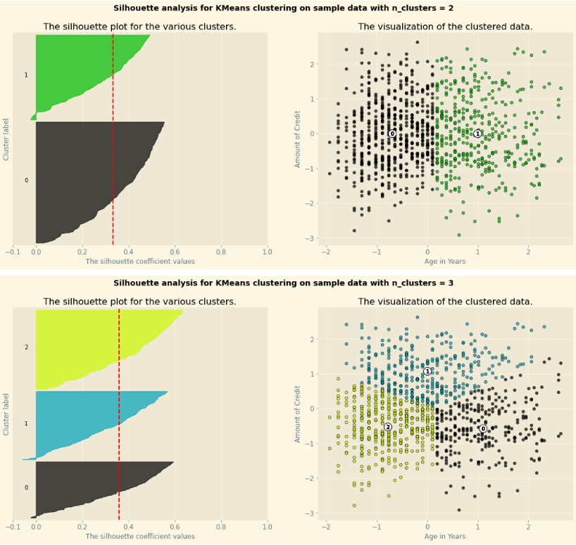
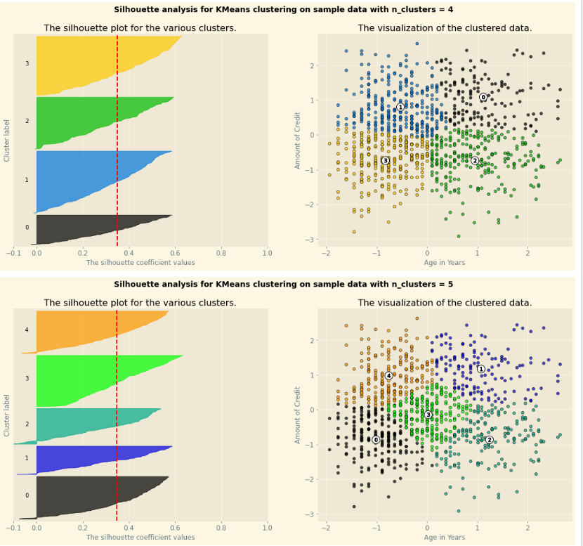
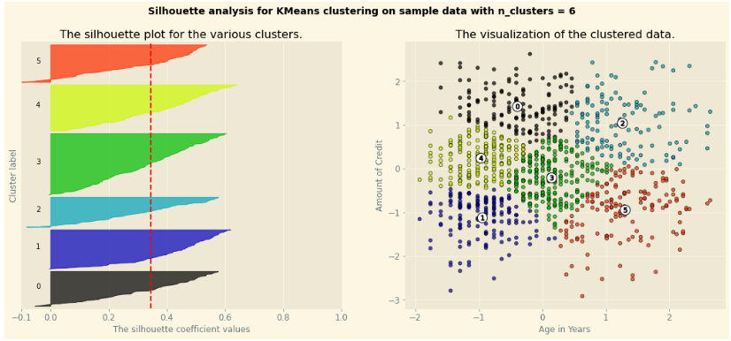
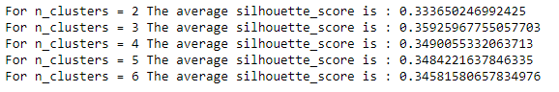
3.1A Optimizing K-Means Clustering Model
with Age_in_Years & Credit_Amount
Using Silhouette Analysis instead of Elbow Method with SSE to obtain optimal number of clusters given that Silhouette Score will be used as our common performance measure
By testing range of K-values from 2 to 6:
N_clusters = 3 has provided the highest Silhouette Score of 0.3593 (4 d.p.)
Notes:
To optimize the following K-Means model we could utilize the Silhouette Analysis technique to determine the optimal number of clusters which would give us the best silhouette score. Hence, by using silhouette analysis score for each cluster, we could then determine how similar and dissimilar the data points are within and beyond each cluster such that 1 would represent the best value with -1 being the worse value possible. Hence, the reason why we are using Silhouette Analysis instead of the elbow technique to observe the Sum of Squared Error for each cluster is because we will be using Silhouette Score as our common performance measure against the Hierarchical Clustering model that will be built subsequently. Thus, by observing the Silhouette plot of the various clusters from 2 to 6, we could observe that n_cluster of 3 is able to provide us the highest average silhouette score of 0.3593.

Slide 25
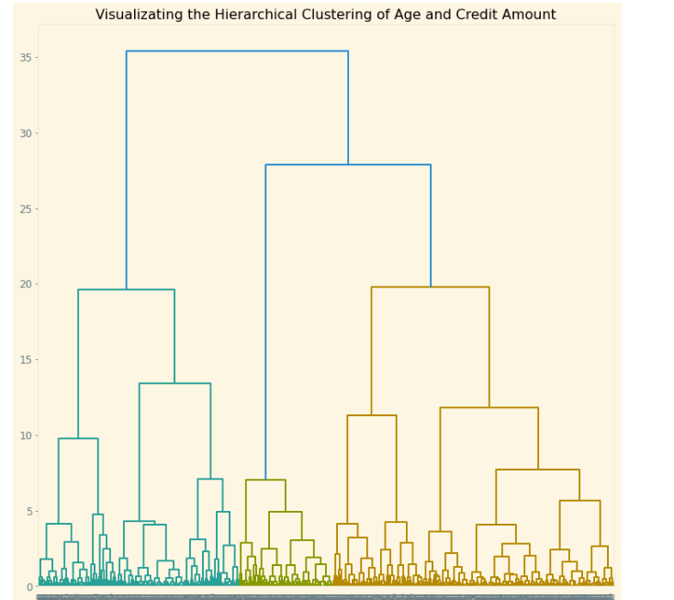
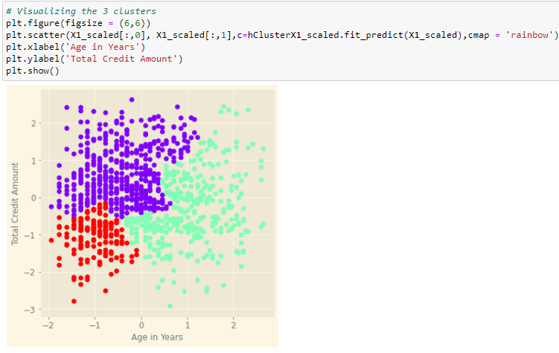
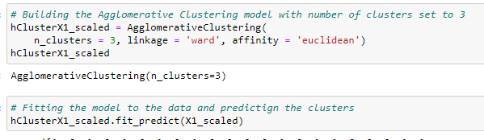
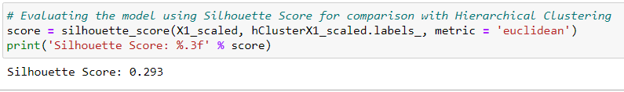
3.1B Building Hierarchical Clustering Model
with Age_in_Years & Credit_Amount
Objective: Understand which age group of bank customers to target based on the credit amount that they have taken (More Credit → Higher Revenue from Interest)
Number of Clusters to build = 3 by observing dendrogram
Notes:
To compare against the K-means clustering model in order to determine which model would provide a higher silhouette score, we would build a hierarchical clustering model with the same variables of Age in Years and Credit Amount. Hence, to firstly determine the number of clusters we should utilize, we could observe the Dendrogram created from the Age and Credit Amount feature which shows that 3 would be the optimal number of clusters to build with given that it cuts the maximum vertical distance observed. Hence, by using the 3 clusters and ward linkage to build the agglomerative clustering model before fitting the entries to their respective clusters, we could observe that the hierarchical clustering model is able to produce a Silhouette Score of 0.293.

Slide 26
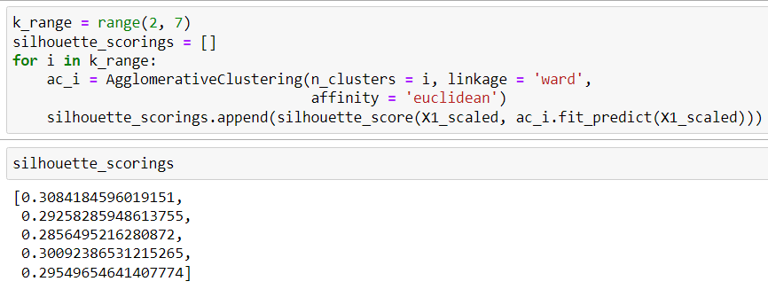
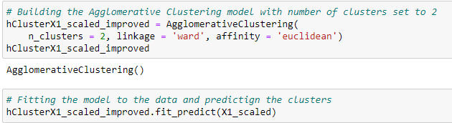
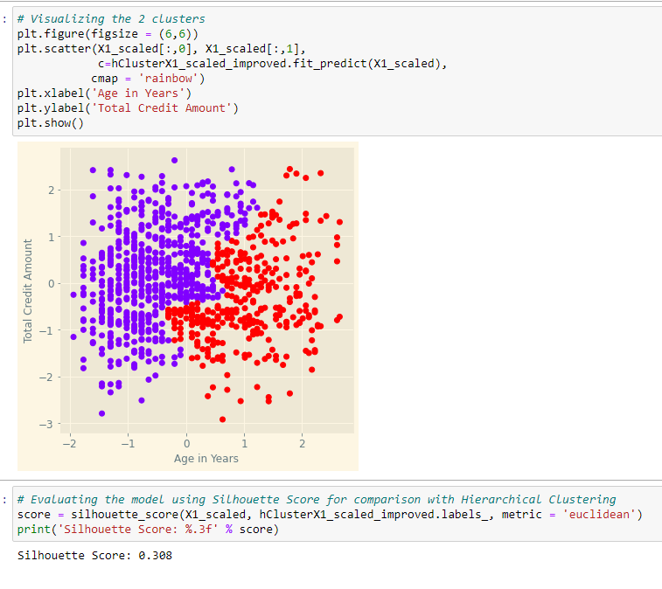
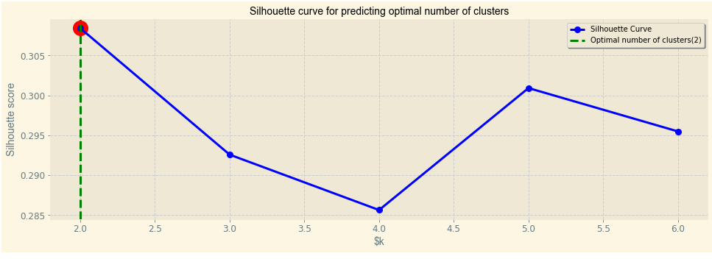
3.1B Optimizing Hierarchical Clustering Model
with Age_in_Years & Credit_Amount
Silhouette Scores by testing K-Values from 2 to 6
Building Hierarchical Clustering Model (K=2)
By testing range of K-values from 2 to 6:
N_clusters = 2 has provided the highest Silhouette Score of 0.3084 (4 d.p.)
Notes:
To optimize the following hierarchical clustering model, we could test the various number of cluster values from 2 to 6 in order to determine the number of clusters which would produce the highest Silhouette Score. Thus, by creating a function to loop through a range of n_clusters from 2 to 6 and storing and plotting the list of Silhouette Scores, we could observe that n_cluster = 2 would provide us the highest silhouette score of 0.3084 which is slightly better than the initial model created which had a Silhouette Score of 0.293.

Slide 27
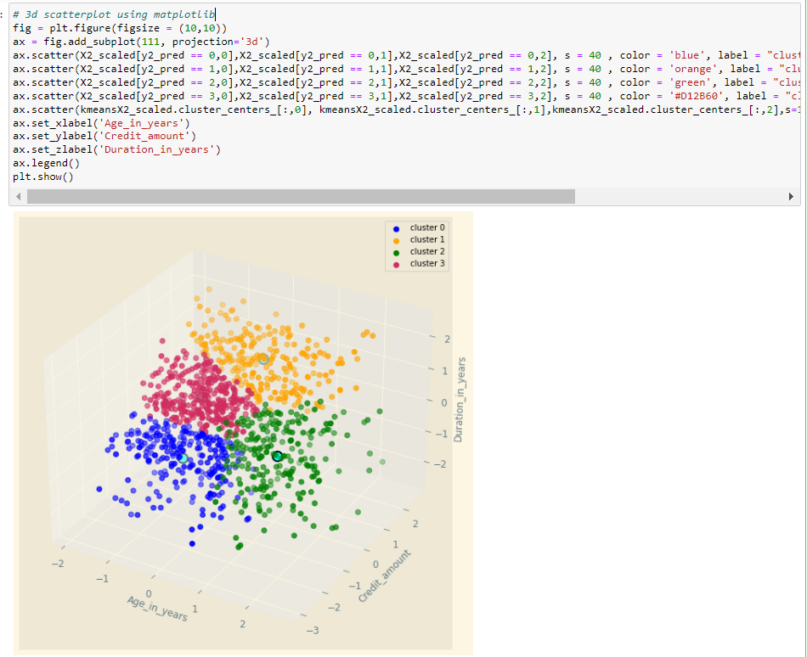
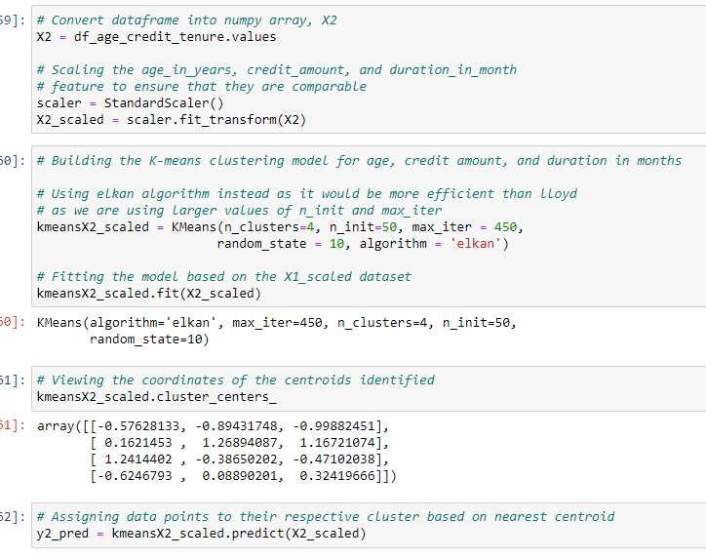
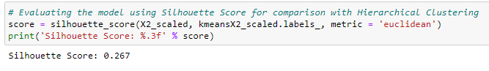
3.2A Building K-Means Clustering Model
with Age_in_Years, Credit_amount, Duration_in_year
Objective: Understanding the relationship of credit amount and loan tenure based on different age of bank customers
Z-Score Transformation
Building with 4 Clusters
Initially and fitting model
Assigning Cluster Group
Notes:
As for our second K-Means model which utilizes the variables age in years, credit amount, and duration in years, the objective of this model alongside the hierarchical clustering model that we will be building subsequently aims to understand how the amount of credit taken affects the loan tenure taken to repay the loan based on the different ages of the bank’s customers. Hence, for the K-Means model we had firstly extracted the age, credit amount, and duration in years column in a new dataframe and had converted it into a numpy array using .values object under X2. After which, we had performed Z-Score Transformation on top of the log transformation we had performed previously in order to scale the age in years, credit amount, and duration in years feature to the same range and magnitude of comparison. Following, we had build the K-means model starting with 4 clusters and had assigned them to their following clusters. Hence, as Silhouette Score would be used as the common performance measure among the K-means and Hierarchical Clustering model that we will build instead of the Sum of Squared Errors, we could observe that we have successfully obtained a Silhouette Score of 0.267.

Slide 28
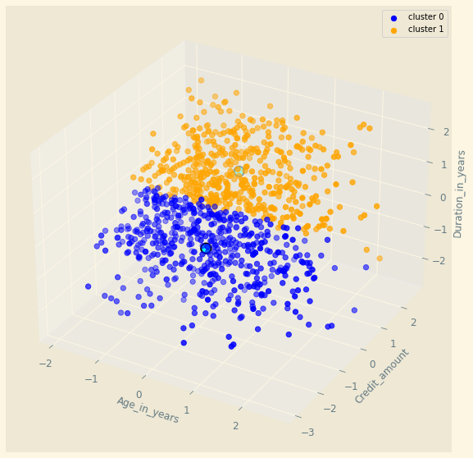
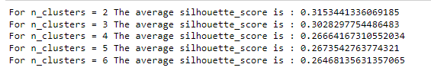
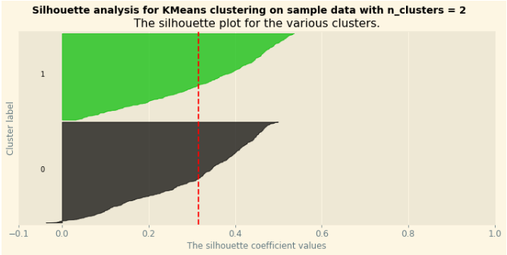
3.2A Optimizing K-Means Clustering Model
with Age_in_Years, Credit_amount, Duration_in_year
Using Silhouette Analysis instead of Elbow Method with SSE to obtain optimal number of clusters given that Silhouette Score will be used as our common performance measure
By testing range of K-values from 2 to 6:
N_clusters = 2 has provided the highest Silhouette Score of 0.3153 (4 d.p.)
Notes:
To optimize the following K-Means model we could utilize the Silhouette Analysis technique to determine the optimal number of clusters which would give us the best silhouette score. Hence, by using silhouette analysis score for each cluster, we could then determine how similar and dissimilar the data points are within and beyond each cluster such that 1 would represent the best value with -1 being the worse value possible. Hence, the reason why we are using Silhouette Analysis instead of the elbow technique to observe the Sum of Squared Error for each cluster is because we will be using Silhouette Score as our common performance measure against the Hierarchical Clustering model that will be built subsequently. Thus, by observing the Silhouette plot of the various clusters from n_cluster values from 2 to 6, we could observe that n_cluster of 2 is able to provide us the highest average silhouette score of 0.3153.

Slide 29
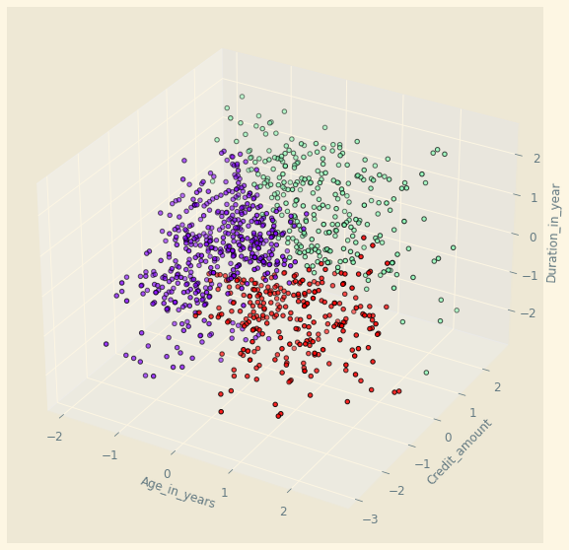



3.2B Building Hierarchical Clustering Model
with Age_in_Years, Credit_amount, Duration_in_year
Objective: Understanding the relationship of credit amount and loan tenure based on different age of bank customers
Number of Clusters to build = 3 by observing dendrogram
Notes:
To compare against the K-means clustering model in order to determine which model would provide a higher silhouette score, we would build a hierarchical clustering model with the same variables of Age in Years, Credit Amount, and Duration in Years. Hence, to firstly determine the number of clusters we should utilize, we could observe the Dendrogram created from the Age in Years, Credit Amount, and Duration in Years feature which shows that 3 would be the optimal number of clusters to build with given that it cuts the maximum vertical distance observed. Hence, by using the 3 clusters and ward linkage to build the agglomerative clustering model before fitting the entries to their respective clusters, we could observe that the hierarchical clustering model is able to produce a Silhouette Score of 0.241.

Slide 30




3.2B Building Hierarchical Clustering Model
with Age_in_Years, Credit_amount, Duration_in_year
Silhouette Scores by testing K-Values from 2 to 6
Building Hierarchical Clustering Model (K=2)
By testing range of K-values from 2 to 6:
N_clusters = 2 has provided the highest Silhouette Score of 0.2715 (4 d.p.)
Notes:
To optimize the following hierarchical clustering model, we could test the various number of cluster values from 2 to 6 in order to determine the number of clusters which would produce the highest Silhouette Score. Thus, by creating a function to loop through a range of n_clusters from 2 to 6 and storing and plotting the list of Silhouette Scores, we could observe that n_cluster = 2 would provide us the highest silhouette score of 0.2715 which is much better than the initial model created which had a Silhouette Score of 0.241.

Slide 31



3.3A Building K-Means Clustering Model
with Age_in_Years, Present_employment_since, Credit_History
Objective: Understand how the age and number of years since present employment affects the credit history of a Bank Customer
Z-Score Transformation
Building with 4 Clusters
Initially and fitting model
Assigning Cluster Group
Notes:
As for our third K-Means model which utilizes the variables age in years, present employment since, and credit history, the objective of this model alongside the hierarchical clustering model that we will be building subsequently aims to understand how variables such as age and present employment since determine the credit history of an individual. Hence, for the K-Means model we had firstly extracted the age, present_employment_since, and credit history column in a new dataframe and had converted it into a numpy array using .values object under X3. After which, we had performed Z-Score Transformation on top of the log transformation we had performed previously in order to scale the age in years, present employment since, and credit history feature to the same range and magnitude of comparison. Following, we had build the K-means model starting with 4 clusters and had assigned the results to their following clusters. Hence, as Silhouette Score would be used as the common performance measure among the K-means and Hierarchical Clustering model that we will build instead of the Sum of Squared Errors, we could observe that we have successfully obtained a Silhouette Score of 0.345.

Slide 32



3.3A Optimizing K-Means Clustering Model
with Age_in_Years, Present_employment_since, Credit_History
Using Silhouette Analysis instead of Elbow Method with SSE to obtain optimal number of clusters given that Silhouette Score will be used as our common performance measure
By testing range of K-values from 2 to 6:
N_clusters = 2 has provided the highest Silhouette Score of 0.3603 (4 d.p.)
Notes:
To optimize the following K-Means model we could utilize the Silhouette Analysis technique to determine the optimal number of clusters which would give us the best silhouette score. Hence, by using silhouette analysis score for each cluster, we could then determine how similar and dissimilar the data points are within and beyond each cluster such that 1 would represent the best value with -1 being the worse value possible. Hence, the reason why we are using Silhouette Analysis instead of the elbow technique to observe the Sum of Squared Error for each cluster is because we will be using Silhouette Score as our common performance measure against the Hierarchical Clustering model that will be built subsequently. Thus, by observing the Silhouette plot of the various clusters, we could observe that n_cluster of 5 is able to provide us the highest average silhouette score of 0.3603.

Slide 33




3.3B Building Hierarchical Clustering Model
with Age_in_Years, Present_employment_since, Credit_History
Objective: Understand how the age and number of years since present employment affects the credit history of a Bank Customer
Number of Clusters to build = 3 by observing dendrogram
Notes:
To compare against the K-means clustering model in order to determine which model would provide a higher silhouette score, we would build a hierarchical clustering model with the same variables of Age_in_Years, Present_employment_since, and Credit_History. Hence, to firstly determine the number of clusters we should utilize, we could observe the Dendrogram created from the Age_in_Years, Present_employment_since, and Credit_History feature which shows that 3 would be the optimal number of clusters to build with given that it cuts the maximum vertical distance observed. Hence, by using the 3 clusters and ward linkage to build the agglomerative clustering model before fitting the entries to their respective clusters, we could observe that the hierarchical clustering model is able to produce a Silhouette Score of 0.293.

Slide 34




3.3B Optimizing Hierarchical Clustering Model
with Age_in_Years, Present_employment_since, Credit_History
Silhouette Scores by testing K-Values from 2 to 6
Building Hierarchical Clustering Model (K=2)
By testing range of K-values from 2 to 6:
N_clusters = 2 has provided the highest Silhouette Score of 0.3203 (4 d.p.)
Notes:
To optimize the following hierarchical clustering model, we could test the various number of cluster values from 2 to 6 in order to determine the number of clusters which would produce the highest Silhouette Score. Thus, by creating a function to loop through a range of n_clusters from 2 to 6 and storing and plotting the list of Silhouette Scores, we could observe that n_cluster = 2 would provide us the highest silhouette score of 0.3203 which is much better than the initial model created which had a Silhouette Score of 0.293.
Score of 0.241.

Slide 35



3.4A Building K-Means Clustering Model
with Credit_amount, Number_of_existing_credits_at_this_bank, Credit_History
Objective: Understand how Credit Amount and the number of existing credit the customer has taken at the bank affects their credit history
Z-Score Transformation
Building with 4 Clusters
Initially and fitting model
Assigning Cluster Group
Notes:
As for our fourth and final K-Means model which utilizes the variables credit amount, number of existing credits at this bank, and credit history, the objective of this model alongside the hierarchical clustering model that we will be building subsequently aims to understand how the amount of loan taken and the number of existing loans taken at the bank determines the credit history of an individual. Hence, for the K-Means model we had firstly extracted the credit_amount, number_of_existing_credits_at_this_bank, and credit history column in a new dataframe and had converted it into a numpy array using .values object under X4. After which, we had performed Z-Score Transformation on top of the log transformation we had performed previously in order to scale the credit amount,number of existing credits at this bank, and credit history feature to the same range and magnitude of comparison. Following, we had build the K-means model starting with 4 clusters and had assigned the results to their following clusters. Hence, as Silhouette Score would be used as the common performance measure among the K-means and Hierarchical Clustering model that we will build instead of the Sum of Squared Errors, we could observe that we have successfully obtained a Silhouette Score of 0.373.

Slide 36



3.4A Optimizing K-Means Clustering Model
with Credit_amount, Number_of_existing_credits_at_this_bank, Credit_History
Using Silhouette Analysis instead of Elbow Method with SSE to obtain optimal number of clusters given that Silhouette Score will be used as our common performance measure
By testing range of K-values from 2 to 6:
N_clusters = 6 has provided the highest Silhouette Score of 0.4474 (4 d.p.)
Notes:
To optimize the following K-Means model we could utilize the Silhouette Analysis technique to determine the optimal number of clusters which would give us the best silhouette score. Hence, by using silhouette analysis score for each cluster, we could then determine how similar and dissimilar the data points are within and beyond each cluster such that 1 would represent the best value with -1 being the worse value possible. Hence, the reason why we are using Silhouette Analysis instead of the elbow technique to observe the Sum of Squared Error for each cluster is because we will be using Silhouette Score as our common performance measure against the Hierarchical Clustering model that will be built subsequently. Thus, by observing the Silhouette plot of the various clusters, we could observe that n_cluster of 6 is able to provide us the highest average silhouette score of 0.4474.

Slide 37




3.4B Building Hierarchical Clustering Model
with Credit_amount, Number_of_existing_credits_at_this_bank, Credit_History
Number of Clusters to build = 2 by observing dendrogram
Notes:
To compare against the K-means clustering model in order to determine which model would provide a higher silhouette score, we would build a hierarchical clustering model with the same variables of Credit_amount, Number_of_existing_credits_at_this_bank, Credit_History. Hence, to firstly determine the number of clusters we should utilize, we could observe the Dendrogram created from the Credit_amount, Number_of_existing_credits_at_this_bank, Credit_History feature which shows that 2 would be the optimal number of clusters to build with given that it cuts the maximum vertical distance observed. Hence, by using the 2 clusters and ward linkage to build the agglomerative clustering model before fitting the entries to their respective clusters, we could observe that the hierarchical clustering model is able to produce a Silhouette Score of 0.425.

Slide 38




3.4B Optimizing Hierarchical Clustering Model
with Credit_amount, Number_of_existing_credits_at_this_bank, Credit_History
Silhouette Scores by testing K-Values from 2 to 6
Building Hierarchical Clustering Model (K=2)
By testing range of K-values from 2 to 6:
N_clusters = 2 has provided the highest Silhouette Score of 0.4247 (4 d.p.)
Notes:
To optimize the following hierarchical clustering model, we could test the various number of cluster values from 2 to 6 in order to determine the number of clusters which would produce the highest Silhouette Score. Thus, by creating a function to loop through a range of n_clusters from 2 to 6 and storing and plotting the list of Silhouette Scores, we could observe that n_cluster = 2 would provide us the highest silhouette score of 0.4247 which is equivalent to the initial model created given that it also uses the same number of cluster of 2 initially.

Slide 39
Evaluating Clustering Models For Further Analysis
Model | Features | Linkage | SS | Remarks
K-Means 3.1A | Age_in_Years, Credit_Amount | NA | 0.3593 | All K-Means Clustering model have performed much better compared to the alternative Hierarchical Clustering models as observed from the Silhouette Score. Will be used for further analysis to derive business insights from.
K-Means 3.2A | Age_in_Years, Credit_amount, Duration_in_year | NA | 0.3153
K-Means 3.3A | Age_in_Years, Present_employment_since, Credit_History | NA | 0.3603
K-Means 3.4A | Credit_amount, Number_of_existing_credits_at_this_bank, Credit_History | NA | 0.4474
Hierarchical 3.1B | Age_in_Years, Credit_Amount | Ward | 0.3084
Hierarchical 3.2B | Age_in_Years, Credit_amount, Duration_in_year | Ward | 0.2715
Hierarchical 3.3B | Age_in_Years, Present_employment_since, Credit_History | Ward | 0.3203
Hierarchical 3.4B | Credit_amount, Number_of_existing_credits_at_this_bank, Credit_History | Ward | 0.4247
Notes:
Thus, by collating the performance of the various K-Means and Hierarchical Clustering model, we could observe that for all of the features that we have compared with, all of the K-means model have outperformed the hierarchical clustering models in terms of the Silhouette Score. For instance, while K-Means 3.1A has a Silhouette Score of 0.3593, Hierarchical 3.1B only has a Silhouette Score of 0.3084. Thus, given that the K-means model have all outperformed their counterpart, we will be using them for further analysis to derive business insights from.

Slide 40
04
CLUSTER INTERPRETATION
Derive Business Insights from Cluster Interpretation
2022
Notes:
Next, I will be sharing more about what we can interpret from the clusters of the selected models in terms of the business insights and actionable plans we can derive from them.

Slide 41


4.1A Interpretation of K-Means Clustering Model 3.1A
Clusters Findings:
Cluster 0 - (Low Age + Low Credit Amount)
Cluster 1 - (Medium Age + Medium to High Credit Amount)
Cluster 2 - (High Age + Low Credit Amount)

Slide 42
4.1B Interpretation of K-Means Clustering Model 3.1A
Cluster Number | Description | Analytics/Interpretation (RELATIVE)
Cluster 0: Low Age + Low Credit Amount | Median Age of approximately 27 Median Loan Amount of approximately $2,000 | Relatively low credit amount leads to relatively lower interest earned and ultimately revenue. Young Adults are not as profitable.
Cluster 1: Medium Age + Medium-High Credit Amount | Median Age of approximately 34 Median Loan Amount of approximately $5,200 | Relatively high credit amount leads to relatively higher interest earned and ultimately revenue. Medium-Aged Adults Bank Customers are more profitable.
Cluster 2: High Age + Low Credit Amount | Median Age of approximately 46 Median Loan Amount of approximately $2,000 | Relatively low credit amount leads to relatively lower interest earned and ultimately revenue. Senior Adults are not as profitable.
Notes:
By observing the boxplot distribution of the 3 clusters in the previous slide as part of the K-means clustering model 3.1A, we could observe that Cluster 0 has a relatively low median age of 27 with a low median credit amount of approximately $2000. Whereas for Cluster 1, customers within it have a relatively average median age of 34 with a Medium to High median credit amount of $5,200. Additionally, for cluster 2, we could observe that customers within it have a high median age of 46, with a low median credit amount $2,000. Thus, through analyzing the observation, we could see that Medium-aged customers are much more profitable compared to young and senior adult customers given that would take on higher credit amount which implies a larger amount of interest earned for the bank, while less is earned from young adult and seniors given they borrow lower amount of credits which leads to lower interest earned as well.

Slide 43
4.1C Recommendation based on K-Means Clustering Model 3.1A
For Cluster 0 and Cluster 2 (Low/High Age + Low Credit Amount)
Increase interest rate for loans borrowed by these two clusters
Earn more revenue from higher interest rate of small loans
For Cluster 1 (Medium Age + Medium-High Credit Amount)
Offer promotional decreased interest for loans borrowed for big ticket items
Earn more revenue from interest earned of larger number of large loans taken
Consideration
Have to consider Price Elasticity of Demand of Consumer Credit to determine how much to increase or decrease interest rate by in order to remain competitive
Notes:
Thus, in terms of the actionable plans, our recommendation for the bank would be to increase the interest rate for loans lent to young and senior adult customers given that the amount of credit earned is relatively low as a result of the low credit amount that they would take. Hence, this would assist the banks in increasing their revenue from high interest rate small loans. Additionally, for medium aged customers, given that they are likely to borrow large credit amount, the bank could potentially attract more medium-aged customers to borrow large amount through promotional discounted interest rates of loan. Thus, this would allow the bank to earn a larger amount of interest from large loans taken which would outweigh the cost from lowering interest rate slightly. However, as part of our consideration, in order to remain competitive, the price elasticity of demand for consumer credit should be calculated comprehensively to determine the magnitude of change in interest rate so that customers would not find alternatives.

Slide 44



4.2A Interpretation of K-Means Clustering Model 3.2A
Clusters Findings:
Cluster 0 - (Medium Age + Low Credit Amount + Shorter Loan Tenure)
Cluster 1 - (Medium Age + High Credit Amount + Longer Loan Tenure)

Slide 45
4.2B Interpretation of K-Means Clustering Model 3.2A
Cluster Number | Description | Analytics/Interpretation (RELATIVE)
Cluster 0: Medium Age in Years + Low Credit Amount + Low Duration in Years | Median Age of approximately 33 years Median Credit Amount of approximately $2,000 Median Loan Tenure of approximately 1 Year | On average, medium-aged adults with smaller amount of credit take shorter loan tenure. Relatively less profitable for banks due to lower interest earned from smaller credit and shorter time for incurring interest
Cluster 1: Medium Age in Year + High Credit Amount + High Duration in Years | Median Age of approximately 33 years Median Credit Amount of approximately $4,000 Median Loan Tenure of approximately 2 Years | On average, medium-aged adults with larger amount of credit take longer loan tenure. Relatively more profitable for banks due to larger amount of interest earned from larger credit and more interest charges over time
Notes:
By observing the boxplot distribution of the 2 clusters in the previous slide as part of the K-Means Clustering model 3.2A, we could observe that Cluster 0 has a relatively average median age of 33 years, a relatively low median credit amount of $2,000, and a relatively low median loan tenure of 1 year. Whereas for Cluster 0, we could observe that the customers within it have a average median age of 33 years as well, a high median credit amount of $4,000, with a relatively high median loan tenure of 2 years. Thus, through analyzing the 2 clusters, we could see that an average age person who takes a small credit is likely take short loan tenure while those who take a large credit amount is likely to take a longer loan tenure relatively. Thus, we conclude that those who take a small credit amount with short loan tenure are not as profitable compared to customers who take a larger credit amount and longer loan tenure given that the bank is able to earn more interest from cluster 1 through larger amount of interest charged and frequency of interest charged over time.

Slide 46
4.2C Recommendation based on K-Means Clustering Model 3.2A
For Cluster 0 (Medium Age + Low Credit Amount + Low Loan Tenure)
Goal: Get low credit amount customers to take longer loan tenure
Offer new collateralized loan products that give lower interest rate for customers that take longer loan tenure
Marketing campaign that explains the benefit of longer loan tenure
For Cluster 1 (Medium Age + High Credit Amount + High Loan Tenure)
Goal: Maintain high loan tenure for high credit amount customers
Offer loan interest rebates for customers that have a good credit history in order to minimize credit risk
Notes:
Hence, our objective for cluster 0 would be to attract such customers to take on longer loan tenure. Thus, one of the solution would be to offer new loan products that have a lower interest rate when taking longer loan tenures while also making such new loan products collateralized to ensure that the bank does not take on additional risk of default. Additionally, to attract customers to take longer loan tenure, marketing campaigns could be held to promote them by explaining the benefits of it (e.g. better cash flow management). As for cluster 1, given that they are already profitable customers due to the fact they take large amount of loan in the span of longer loan tenure, our objective would be to increase customer loyalty for cluster 1. Hence, to strengthen the customer base for cluster 1, the bank could potentially offer loan interest rebates for customers who have managed to maintain a good credit history. Thus, this would allow the bank to maintain and increase demand for such loan products while at the same time not taking additional credit risk by filtering customers.

Slide 47



4.3A Interpretation of K-Means Clustering Model 3.3A
Clusters Findings:
Cluster 0 - (Medium Age, High Present Employment Since, High Credit History)
Cluster 1 - (Low Age, Medium Present Employment Since, High Credit History)
Cluster 2 - (High Age, Medium Present Employment Since, High Credit History)
Cluster 3 - (Low-Medium Age, Medium Present Employment Since, Low Credit History)
Cluster 4- (High Age, High Present Employment Since, Low Credit History)

Slide 48
4.3B Interpretation of K-Means Clustering Model 3.3A
Cluster Number | Description | Analytics/Interpretation (RELATIVE)
Cluster 0: Medium Age, High Present Employment Since, High Credit History | Median Age of approximately 39, Median Years of Present Employment: > 7, Median Credit History: 2 (encoded) | We could observe that medium aged customers with employment of more than 7 years since is among the groups least likely to default on loans
Cluster 1: Low Age, Medium Present Employment Since, High Credit History | Median Age of approximately 27, Median Years of Present Employment: 1 to 4, Median Credit History: 2 (encoded) | We could observe that young adults with employment of between 1 to 4 years since is among the groups least likely to default on loans
Cluster 2: (High Age, Medium Present Employment Since, High Credit History) | Median Age of approximately 44, Median Years of Present Employment: 1 to 4, Median Credit History: 2 (encoded) | We could observe that senior-aged adult with employment between 1 to 4 years is among the groups leastly like to default on loans
Cluster 3: (Medium Age, Medium Present Employment Since, Low Credit History) | Median Age of approximately 30, Median Years of Present Employment: 1 to 4, Median Credit History: 0 (encoded) | We could observe that medium aged adult with employment between 1 to 4 years is among the groups most likely to default on loans
Cluster 4: High Age, High Present Employment Since, Low Credit History | Median Age of approximately 44, Median Years of Present Employment: >7, Median Credit History: 0 (encoded) | We could observer that senior-aged adult with employment o more than 7 years since is among the groups most likely to default on loans
Notes:
By observing the box plot distribution of the 5 clusters in the previous slide as part of the K-Mean Clustering model 3.3A, we could observe that Cluster 0 has a average median age of 39 years, a high median present employment since of more than 7 years, and with a high median credit history of 2 which has been encoded. Whereas, for cluster 1, we could observe that the customers within it have a low median age of 27 years, a relatively average median present employment since of 1 to 4 years, and a high median credit history of 2 which has been label encoded. As for cluster 2, we could observe that the customers within it have a high median age of 44 years, a relatively average median present employment since of 1 to 4 years, and a high median credit history of 2 which has been label encoded. Subsequently for cluster 3, we could observe that the customers within it have a average median age of 30 years, a relatively average median present employment since of 1 to 4 years, and a low median credit history of 0 which has been label encoded. Last but not least for cluster 4, we could observe that the customers within it have a high median age of 44 years, a relatively high median present employment since of more than 7 years, and a low median credit history of 0 which has been label encoded.
Thus, through analyzing the 5 clusters we could break them down into their respective age groups such that for young adult customers, they pose relatively low risk of credit default as observed from their high credit history in spite the fact that they only have 1 to 4 years of employment. Whereas for medium aged customer, those with employment between 1 to 4 years are likely to default on loans as evident of their poor credit history while those with more than 7 years of employment are least likely to default on loans as evident of their high credit history. As for senior adults, the employment since has an opposite effect on their credit history as compared to medium aged customers given that those with more than 7 years of employment are more likely to default compared to those employed for only 1 to 4 years.

Slide 49
4.3C Recommendation based on K-Means Clustering Model 3.3A
Senior Aged Customers (Median age - 44)
Those with employment of more than 7 years are most likely to default on loans
Those with employment between 1 to 4 years are least likely to default on loans
Goal: Reduce risk of default for those with 7 years of employment
Reduce Debt Servicing Ratio at the bank to 10% of gross monthly income
Medium Aged Customers (30 to 40 Years Old)
Those with employment of more than 7 years are least likely to default on loans
Those with employment between 1 to 4 years are most likely to default on loans
Goal: Reduce risk of default for those with 1 to 4 years of employment
Limit those with 1 to 4 years of employment to collateralized and/or small loans
Young Adult Customers (Median Age - 27)
Not likely to default on loan
Goal: Attract young adults to take loans given that they are not likely to default on loans if they have worked 1 to 4 years
Offer new loan products: Work-Study Programme Loans that encourages working young adults to continue upskilling
Notes:
Hence, our objective for senior aged customers with more than 7 years of employment since would be to reduce the risk of loan default which could potentially be achieved by reducing their debt servicing ratio at the banks to 10% of their gross monthly income. Hence, this would prevent customers from borrowing more than they could afford to effectively. As for medium aged customers with employment between 1 to 4 years, our objective for this group of customers would also be to reduce their risk of loan default which could potentially be achieved by limiting such customers to only collateralized and or small loans. Hence, this would aid the bank in minimizing their credit risk for this group of customers which are likely to default on their loans. Last but not least, given that young adult customers are less likely to default on their loan, our objective for this group of customers would be to attract more young adults to take on loan at the bank given that they do not pose much risk of credit default. Hence, this could be achieved by offering innovative loan products such as a work-study programme loan that encourage working young adults to continue upskilling through financial support provided.

Slide 50



4.4A Interpretation of K-Means Clustering Model 3.4A
Clusters Findings:
Cluster 0 - (Medium Credit Amount + Low Number of Existing Credit + High Credit History)
Cluster 1 - (Low Credit Amount + High Number of Existing Credit + Low Credit History)
Cluster 2 - (High Credit Amount + High Number of Existing Credit + Low Credit History)
Cluster 3 - (Low Credit Amount + Low Number of Existing Credit + High Credit History)
Cluster 4 - (Medium Credit Amount + Low Number of Existing Credit + Low Credit History)
Cluster 5 - (Medium Credit Amount + High Number of Existing Credit + High Credit History)

Slide 51
4.4B Interpretation of K-Means Clustering Model 3.4A
Cluster Number | Description | Analytics/Interpretation (RELATIVE)
Cluster 0: Medium Credit Amount, Low Number of Existing Credit, High Credit History | Median Credit Amount: Approximately $3800, Median no. of Credit: 1, Median Credit History: 2 (Encoded) | In general, customers with multiple credits have a higher chance of defaulting on loans compared to customers holding onto a single loan regardless of the amount of money borrowed
Cluster 1: Low Credit Amount, High Number of Existing Credit, Low Credit History | Median Credit Amount: Approximately $2000 , Median no. of Credit: 2, Median Credit History: 0 (Encoded)
Cluster 2: High Credit Amount, High Number of Existing Credit, Low Credit History | Median Credit Amount: Approximately $4900, Median no. of Credit: 2, Median Credit History: 0(Encoded)
Cluster 3: Low Credit Amount, Low Number of Existing Credit, High Credit History | Median Credit Amount: Approximately $2000, Median no. of Credit: 1, Median Credit History: 2(Encoded)
Cluster 4: Medium Credit Amount, Low Number of Existing Credit, Low Credit History | Median Credit Amount: $2500, Median no. of Credit: 1, Median Credit History: 0(Encoded) | Cluster 4 is an exception whereby customers holding on to 1 loan also have a poor credit history
Cluster 5: Medium Credit Amount, High Number of Existing Credit, High Credit History | Median Credit Amount: $2900, Median no. of Credit: 2, Median Credit History: 2(Encoded) | Cluster 5 is another exception whereby customers hold on to more than 1 line of credit but have a good credit history
Notes:
By observing the box plot distribution of the 6 clusters in the previous slide as part of the K-Means Clustering model 3.4A, we could observe that Cluster 0 has a average median credit amount fo $3,000, a low median number of credit of 1, and a high median credit history of 3 which has been label encoded. Whereas, for cluster 1, we could observe that the customers within it have a low median credit amount of $2,000, a high median number of existing credit of 2, and a low median credit history of 0 which has been label encoded. As for cluster 2, we could observe that the customers within it have a high median credit amount of $4,900, a high median number of existing credit of 2, and a low median credit history of 0 which has been label encoded. Subsequently for cluster 3, we could observe that the customers within it have a low median credit amount of $2,000, a low median number of existing credit of 1, and a high median credit history of 2 which has been label encoded. After which, for cluster 4 and 5 which forms the exceptions of our interpretation, we could observe that they both have a medium credit amount of $2,500 and $2,900 respectively, a number of existing credits of 1 and 2 respectively, and a median credit history of 0 and 2 respectively.
Thus, through analyzing the 6 clusters we could break them down into two groups which are mainly customers with a single line of credit and customers with multiple lines of credit given that through our analysis, credit amount does not play an effective role in determining credit history of a customer. Thus, in general we could observe that customers with multiple lines of credit are more likely to default on loans compared to those with a single line of credit as observed from their respective credit history.

Slide 52
4.4C Recommendation based on K-Means Clustering Model 3.4A
Customers who have multiple line of credit
Goal: Reduce Risk of loan default
Customers who have 0 or a single line of credit
Goal: Encourage customers to take on loan while discouraging those with a single line of credit from taking on another loan
Actionable Plan
Offer attractive and cheap interest rate for bank customers taking on their first loan while increasing the interest rate of subsequent loans taken
Limit customers to collateralized loans from the second loan taken onwards
Notes:
Hence, as our goal for customers with multiple lines of credit would be to reduce their risk of default on loans as evident of their credit history, and in view of the fact that our objective for customers with a single line of credit would be to encourage them to take up 1 and not more 1 line of credit, our recommendation for the bank would be offer an attractive loan through discounted interest for bank customers who have not take up their first loan while increasing the interest on subsequent lines of credit taken. Hence, this would disincentivize customers from taking more than 1 line of credit. Rather than disincentive customers from taking more than 1 loan, another way would be to only limit customers to collateralized loans if they wish to take subsequent loans. Thus, this would increase the revenue of banks while also reducing their credit risk from the customer’s likelihood to default on loans.

Slide 53
THANK YOU!
Notes:
With that, I have come to the end of my presentation and thank you all for your kind attention.

